Slide 1
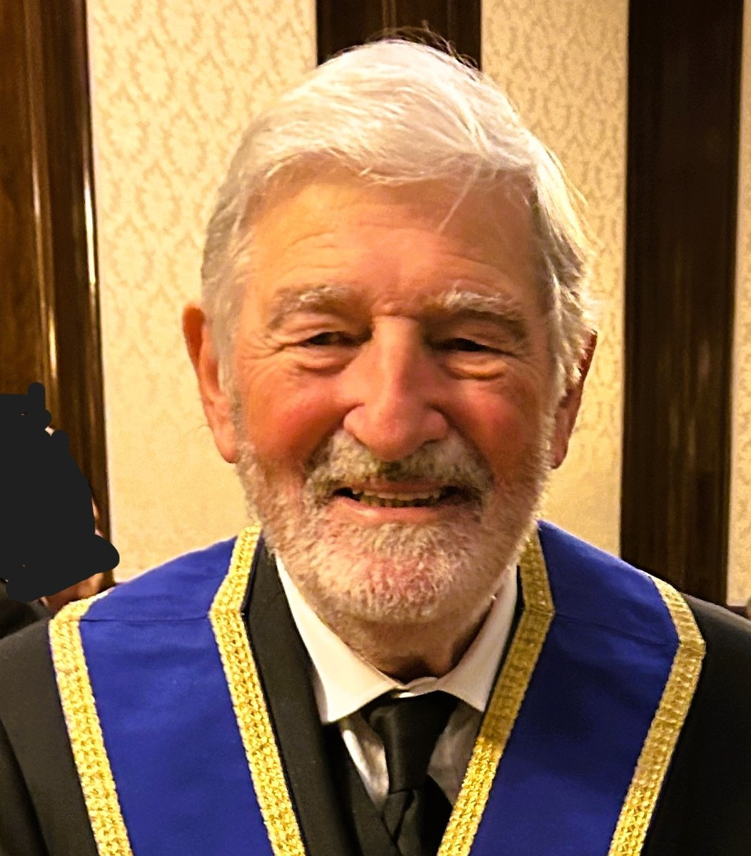
VISITING
OFFICER MEETING
.
Brian King
MetAGInsp
Notes:
Over the last few years, many lodges have expressed concern about falling attendance, difficulty in attracting new candidates, and retaining existing members.
But alongside these challenges, some lodges are doing brilliant things – finding new energy, new ideas, and real success with local recruitment.
Nevertheless, there continues to be a 2% decline in membership – and the reason appears to be lack of successful change management. This is very common. Most people don’t like change – and are very good at frustrating attempts to make changes unless it is their idea, and what they have chosen to do.
We have accepted this reality. We will work with those Lodges who want to make changes and are determined to do it. We will help them succeed. We will rely on the growing awareness of the benefits of successful change to convince the rest.
To deliver this support, we need a new breed of Visiting Officer. Ones able to build a much closer trusting partnership with his Lodges. We have now appointed new Visiting Officer, often with previous experience of successful change management. Our new Inspectorate organisation is designed to support and further develop them;

Slide 2
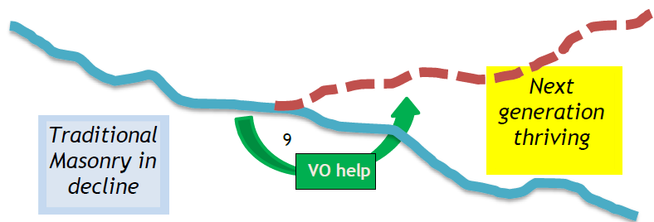
OUR PURPOSE 2025
OUR NEXT STEP
VOs directly responsible
for helping Lodges Grow
.

Slide 3
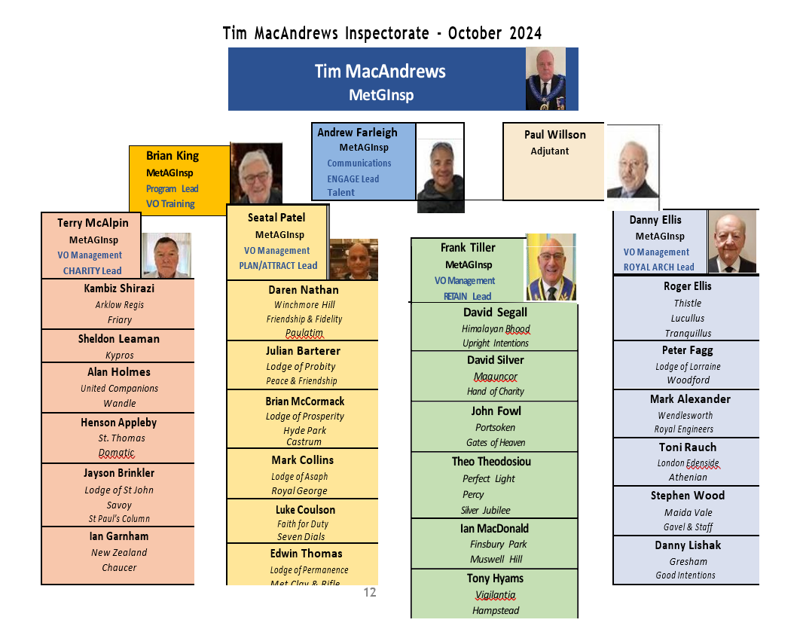
We built our organisation

Slide 4
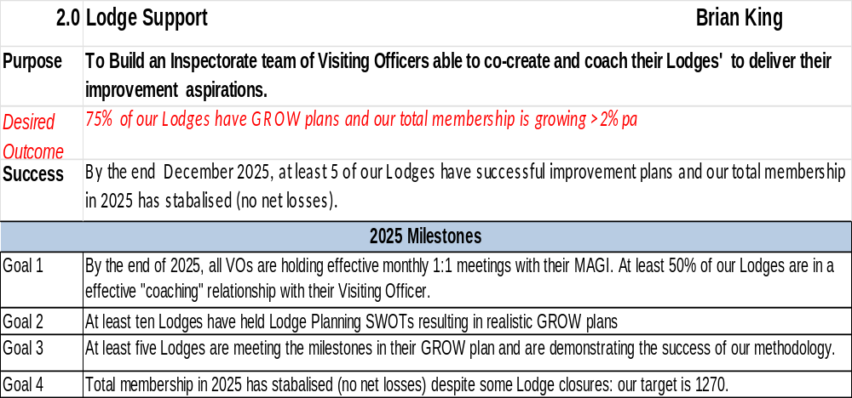
We Built our Plan

Slide 5
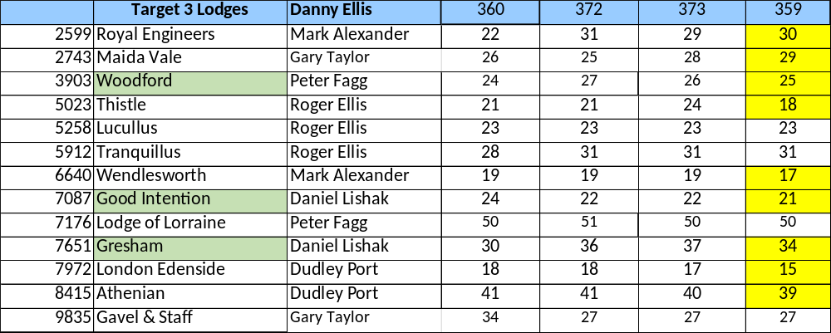
Lodge Membership Numbers – a reality check
To be updated
.

Slide 6
Our achievements in 2025
38%
0%
0%
+1

Slide 7
Our Learnings in 2025
Our vision appears attractive but complex and we have too few customers. We need to better match what Lodges wish to buy.
Too few VOs have gained the confidence of their Lodges.
Our Information Systems and Training has not kept pace.
4. We have not fully exploited MetGL support.
We are on our way - but have further to go.

Slide 8
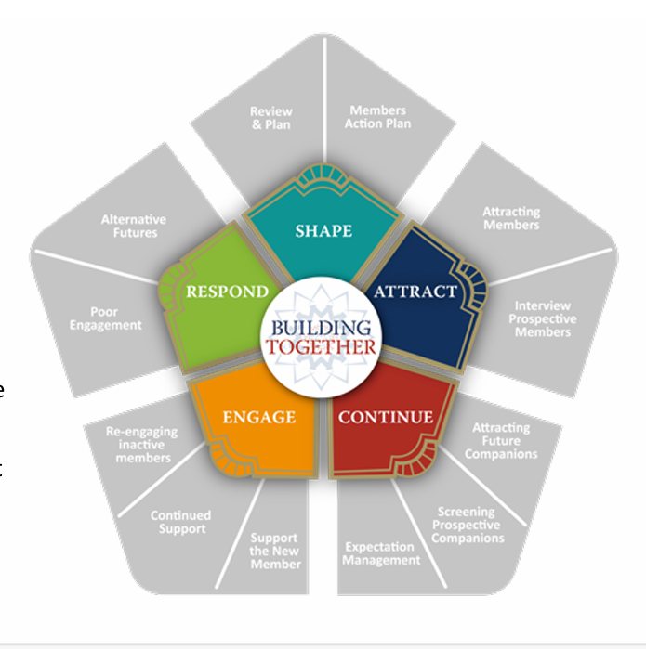
Our Proposed Changes in 2026
Our vision appears attractive but complex and we have too few customers. We need to better match what Lodges will buy.
Bite-sized support to help a Lodge do what they desire.
We are on our way - but have further to go.

Slide 9
Our Proposed Changes in 2026
Too few VOs have gained the confidence of their Lodges.
Allow VOs lacking time or inclination to step back with honour.
More management1:1
New training
We are on our way - but have further to go.

Slide 10
Our Proposed Changes in 2026
Our Information Systems and Training has not kept pace with your needs
Greater Focus
New Triage Report
New Information Officer
New Training Manager
More resources
We are on our way - but have further to go.

Slide 11
Our Proposed Changes in 2026
4. We have not fully exploited MetGL support
An Inspectorate priority
We are on our way - but have further to go.

Slide 12
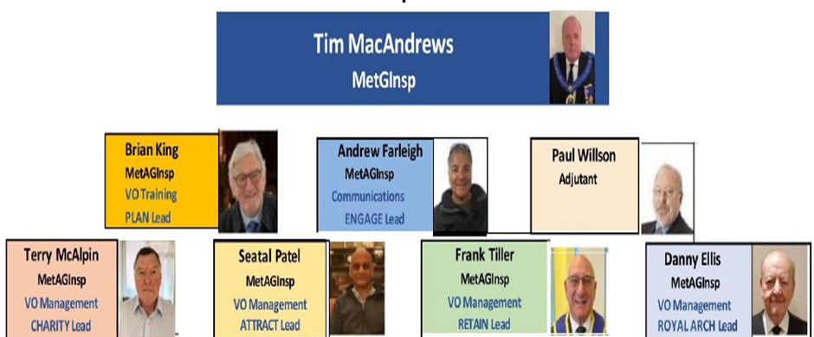
We our organisation has three changes
Mark, Julian Adjutant, Information Lead
Brian: SHAPE Lead VO Training Andrew ENGAGE Lead Communications
Terry same, Seatal same, Frank Anthony RESPOND Lead VOMan, Danny same
VO org same\?

Slide 13
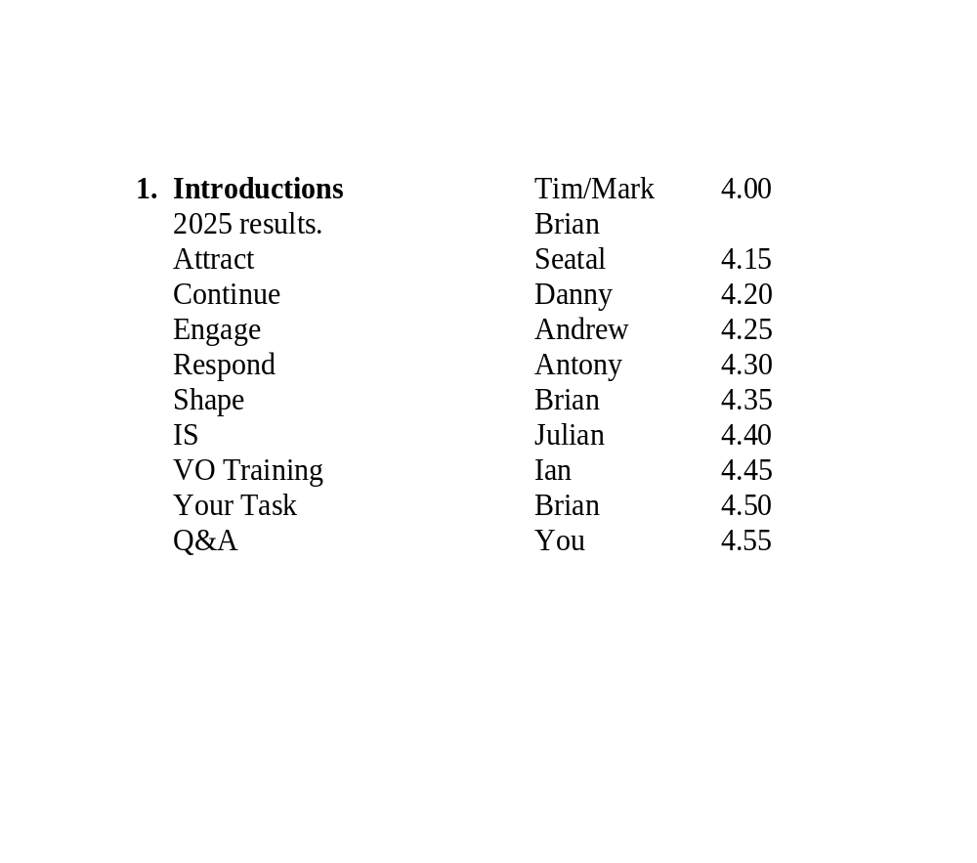
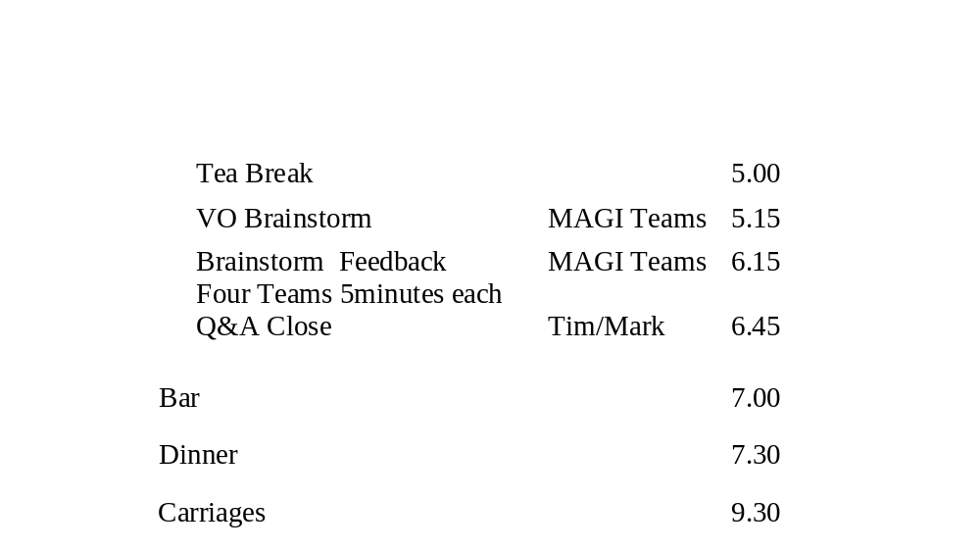
What next?
We are on our way - but have further to go.

Slide 15
What next?
We are on our way - but have further to go.

Slide 16
Brainstorm A
Do you support our plan?
What help do you need?
Our vision appears attractive but complex and we have too few customers. We need to better match what Lodges will buy.
Too few VOs have gained the confidence of their Lodges.
Our Information Systems and Training has not kept pace with the needs.
4. We have not fully exploited MetGL support.
We are on our way - but have further to go.

Slide 17
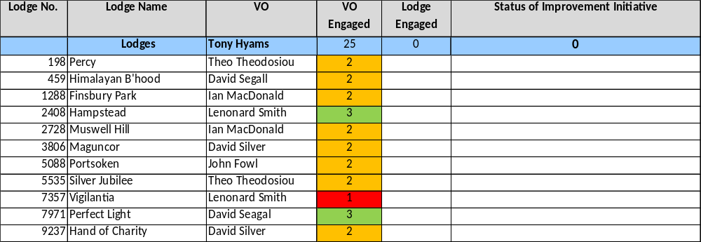

Brainstorm B What engagement can you achieve with your Lodge(s)
Resistant: possibly anti Met | 0 | XXX
Friendly but in denial: not for us | 1 | X
Curious but unsure: too dificult | 2 | ?
Positive; want to take action | 3 | +
Already a successful Lodge | 4
Which Focus?
Progress?

Slide 18
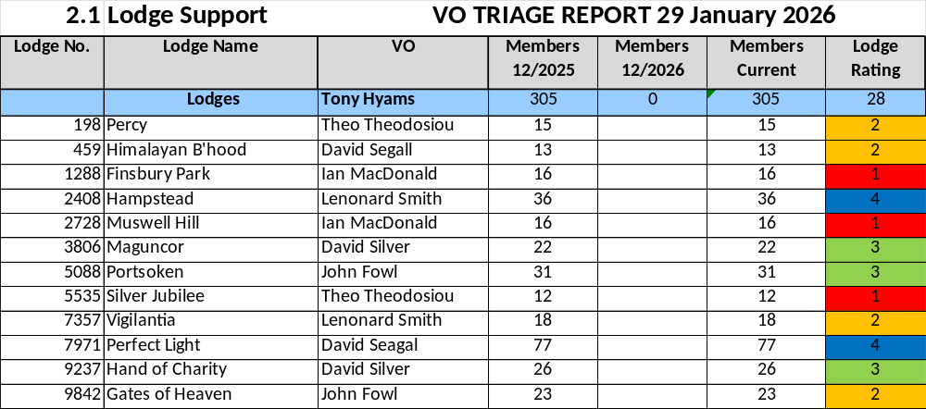
Brainstorm C What is your year end membership forecast?
Your Forecast

Slide 19
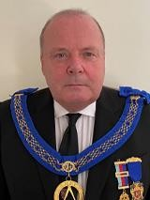
Tim MacAndrews
MetGInsp PSGD
Building Together
.
Notes:
Instructions : how to ask questions

